Slide 2
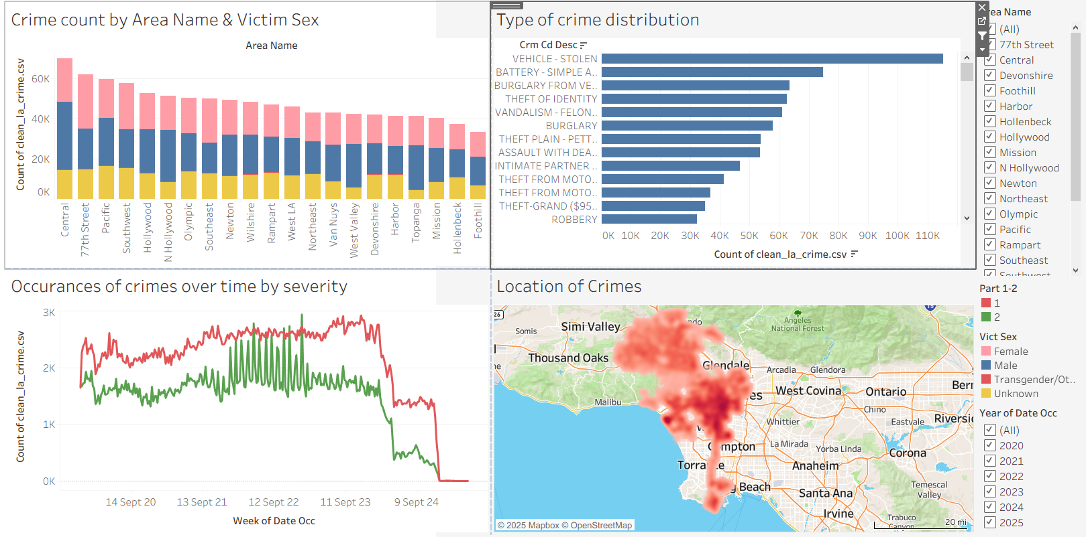
Interactive Dashboard

Slide 3
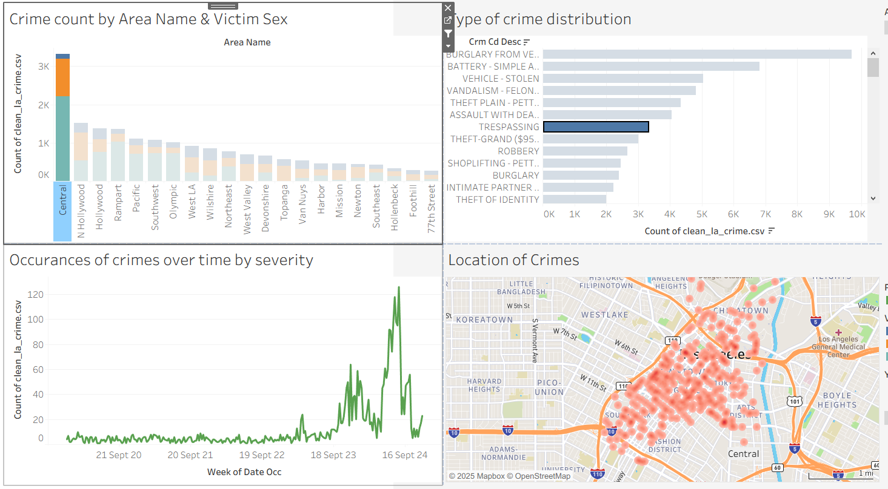
Interactive Dashboard
Combination of side-bar filtering and visualisation filtering to arrive at insights
Trespassing showing a rapid increase in 2024/2025, especially in Central
Investigate to understand why this increase is happening

Slide 4
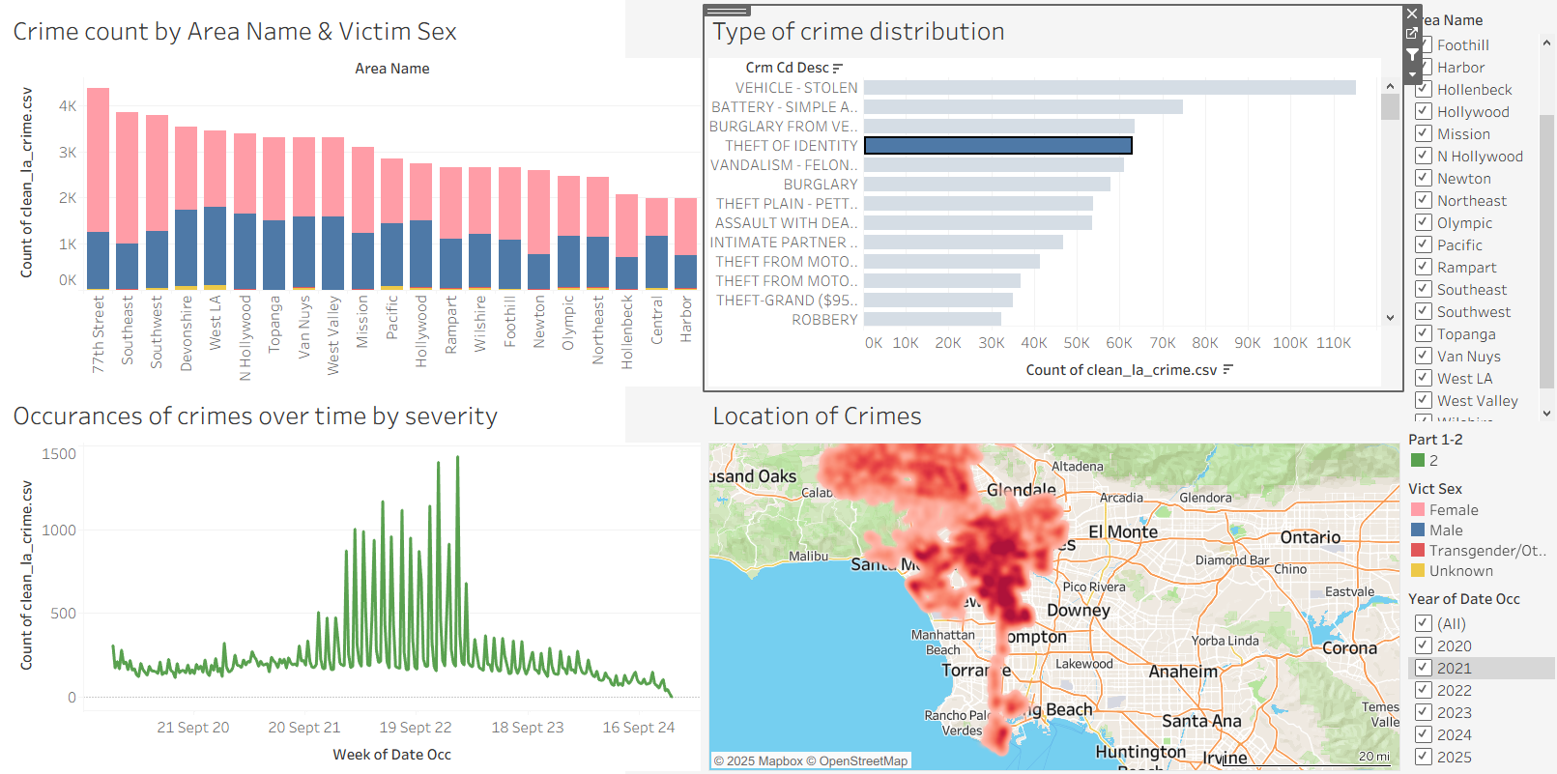
Theft of Identity
Affecting a higher number of females across all areas
High data peaks on the 1st of the month from late 2021 through 2022, suggesting possible crime documentation errors.

Slide 5
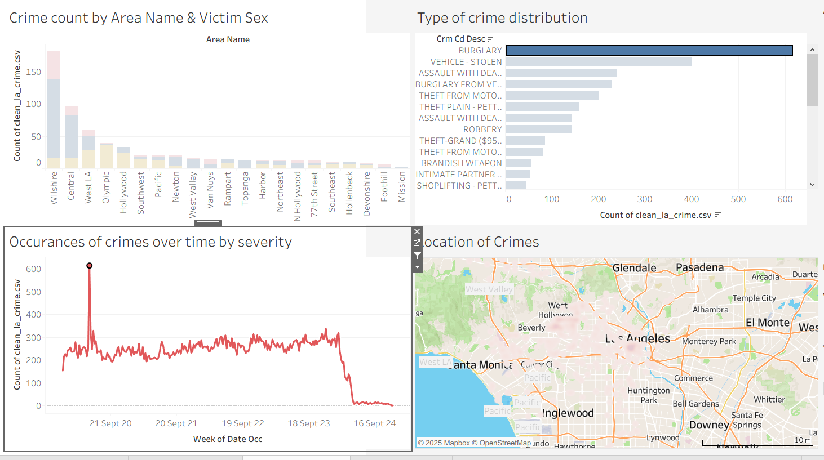
Burglary
Peak evident week of 25 May 2020
Large surge of burglaries in Wilshire at this time
Further investigation required as to why this happened at that time in that area

Slide 6
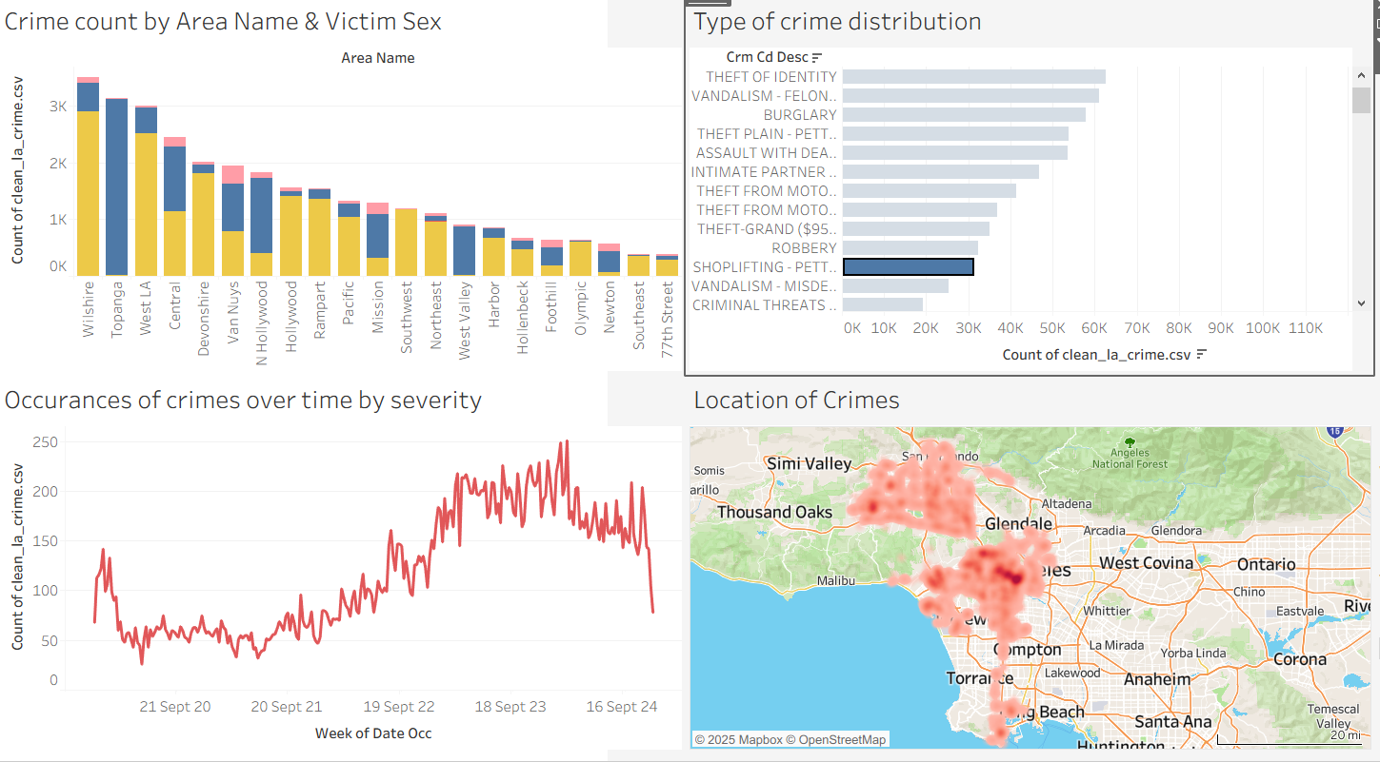
Shoplifting
Instances of shoplifting increasing steadily over time
Wilshire, Topanga and West LA worst affected
Recommendation to increase amount of CCTV in these areas to deter crime

Slide 7
Hourly Instances of crimes by area
- Granular data for deciding where and when to deploy resources.

Slide 8
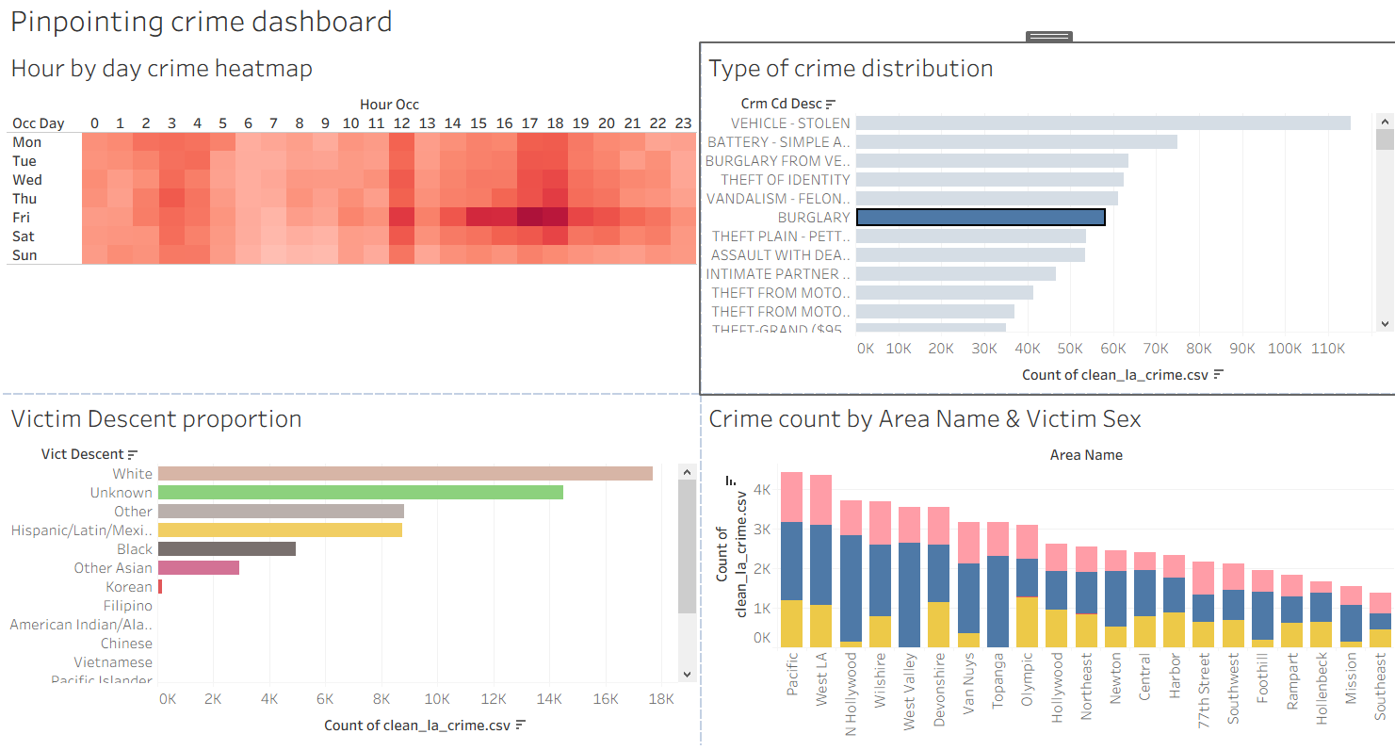
Dashboard 2
Heatmap shows peak times for reported crimes
Eg. burglary most frequent between 15h and 18h on Fridays
Victim descent predominantly white in case of burglary
Pacific and West LA neighbourhoods with most incidences of burglary

Slide 9
Conclusions
Interactive dashboard very useful for investigating crime data
Data reporting of LAPD generally of high quality, however could be improved by more accurate time & age reporting to eradicate data artefacts and artificial spikes.
Many analyses possible from this dataset, more specific instructions from stakeholders would aid in focussed drilling down of data to gain insights.

